Slide 1
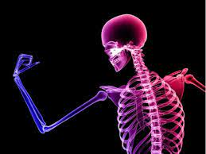
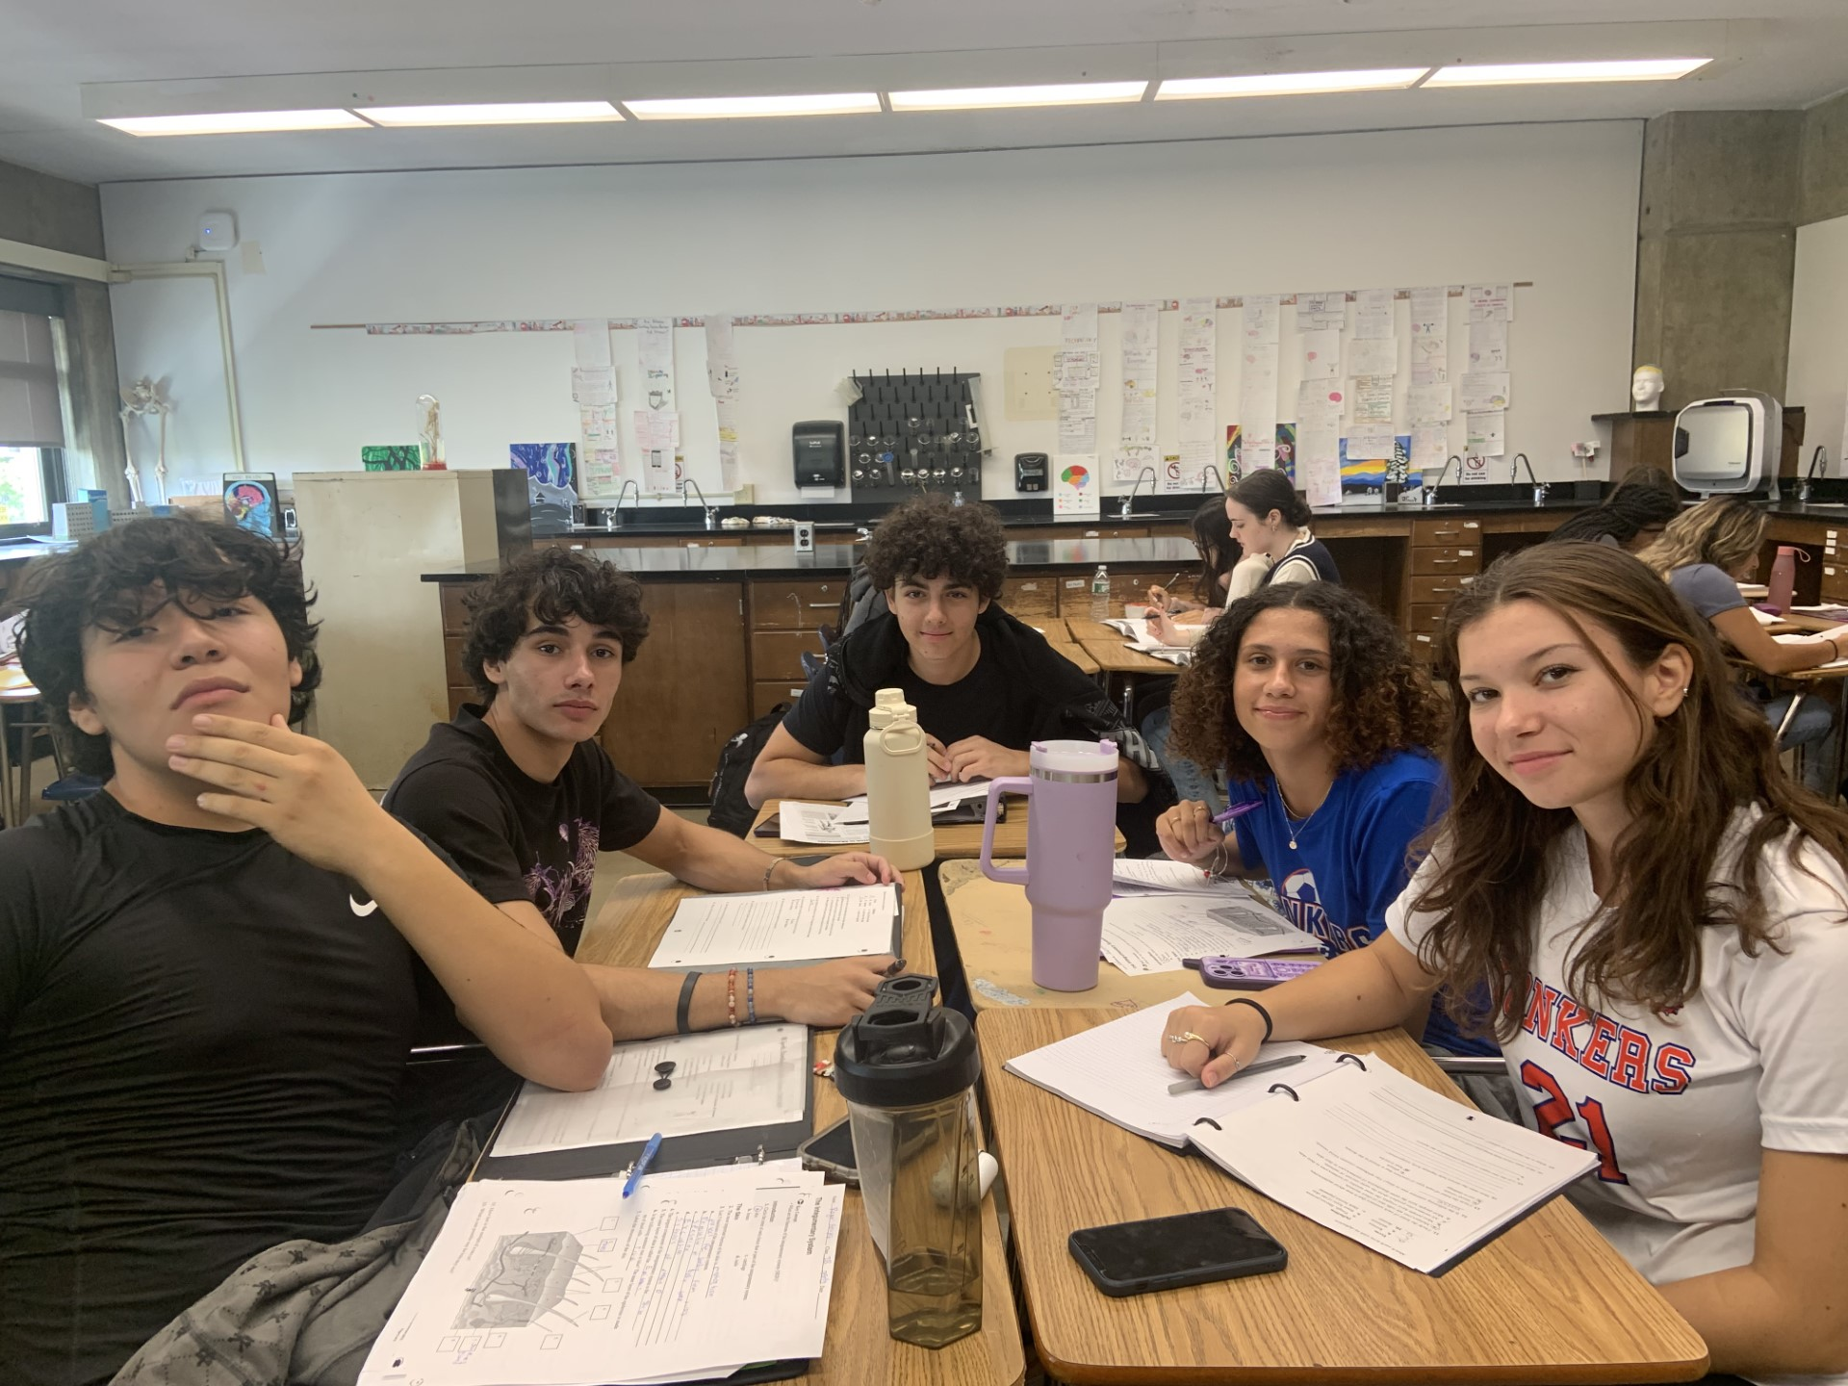
Welcome to IB Sports, Exercise & Health Science HL Mrs. Crista Castelli

Slide 2
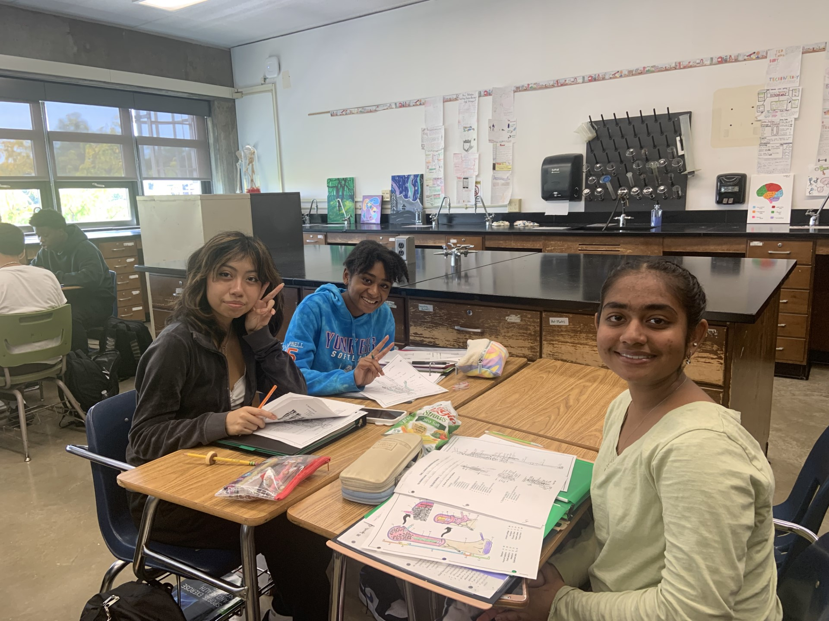
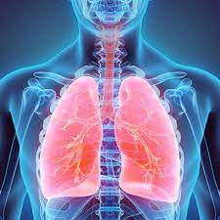
IB SEHS Topics
Anatomy: Skeletal & Muscular Systems
Exercise Physiology: Ventilatory & Cardiovascular Systems
Energy Systems: Nutrition & Metabolism
Movement Analysis
Skill in Sport
Measurement and Evaluation of Human Performance
Option C: Physical Activity & Health
Option D: Nutrition

Slide 3
IB SEHS HL Additional Topics
Further Anatomy: Endocrine Systems, the Skin and the Brain
Fatigue
Skill Acquisition & Analysis
Genetics & Athletic Performance
Exercise and Immunity

Slide 4
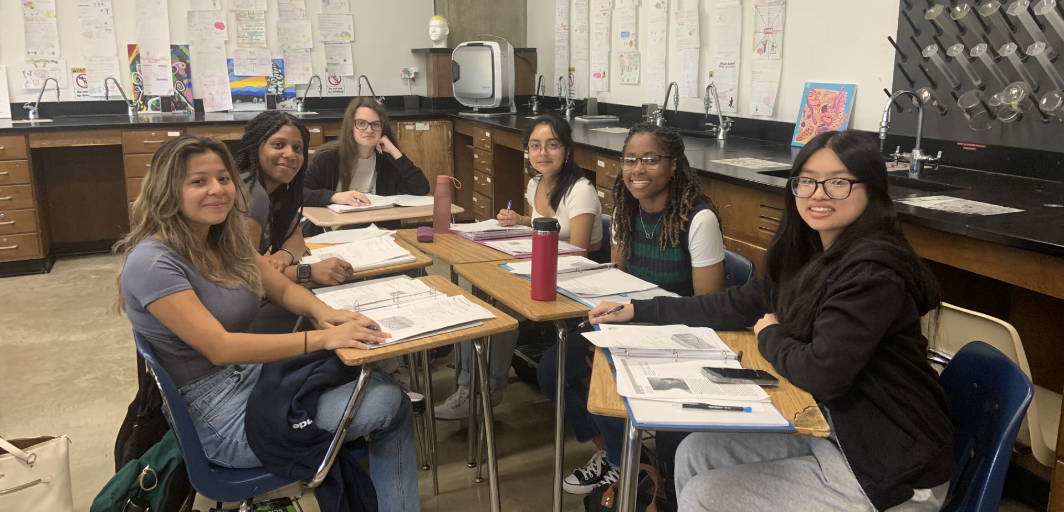
Materials
Binder
Textbook (Year 1)
Lab Folder
EdPuzzle Account
Schoology
Grades are posted in Powerschool
https://www.yonkerspublicschools.org/parentportal

Slide 5
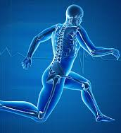
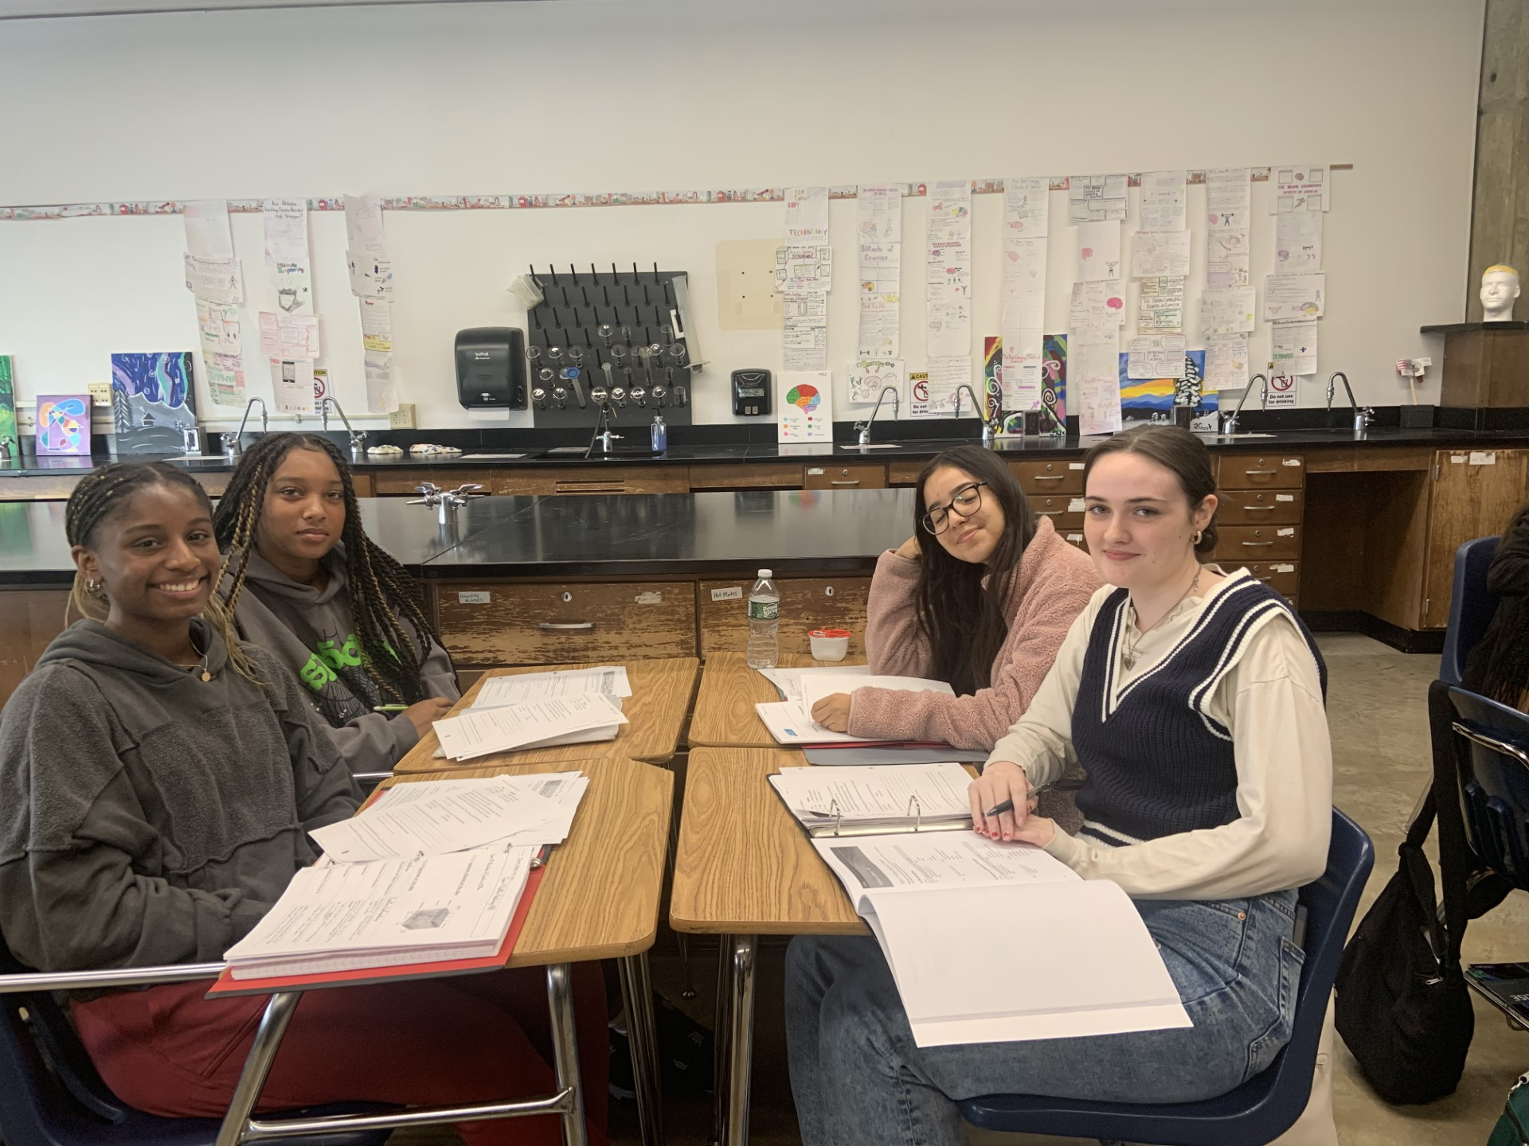
Schoology
Announcements & Reminders will be posted on Schoology.
All class notes and important files are also posted in schoology.
https://yonkersps.schoology.com/
Students and parents can reach me via e-mail.

Slide 6
Grading Policy
Tests and Quizzes 50%
Homework / Classwork 25%
Laboratory 25%
Students are required to submit an independent Internal Assessment (design an experiment/investigation) in February of Year 2
The IB SEHS course culminates in an IB Exam that will be administered in May.

Slide 7
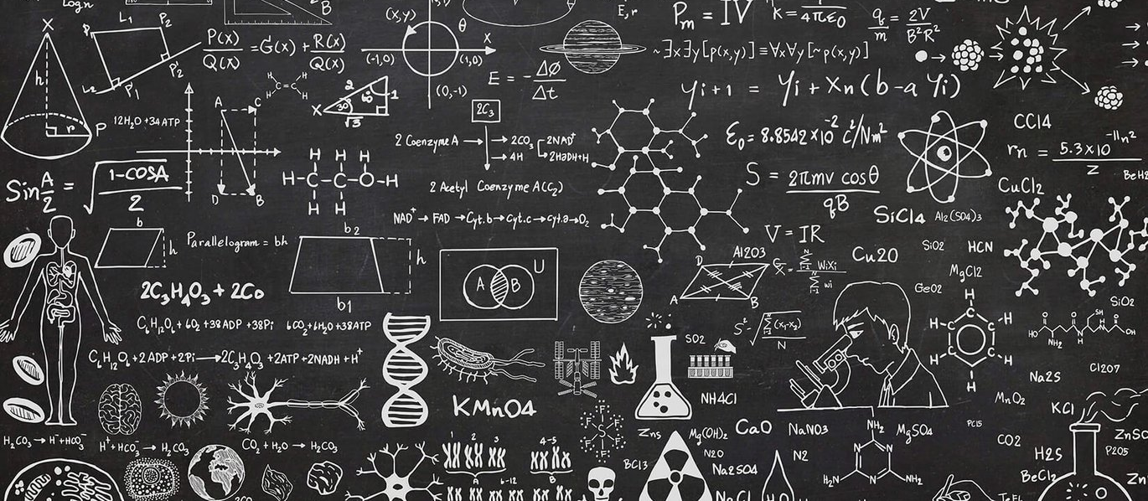
E-Mail Address
ccastelli@yonkerspublicschools.org

Slide 8
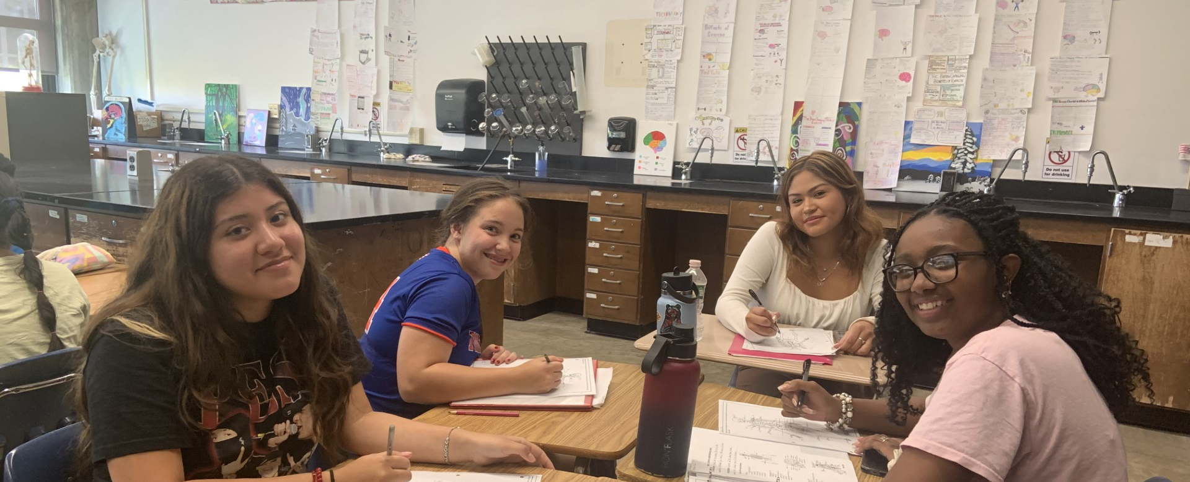
Extra Help
Extra Help -
every Tuesday after school until 3:15 pm.

Slide 9
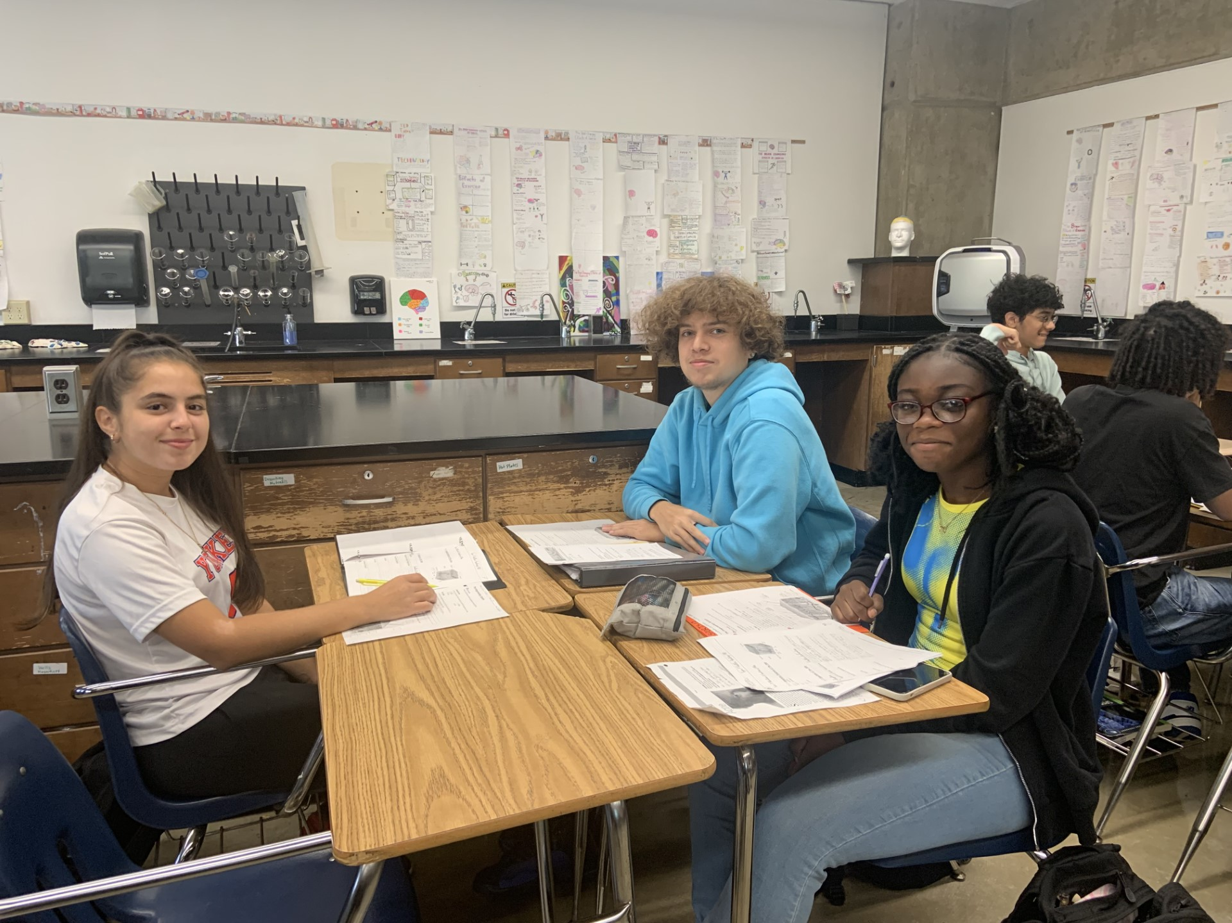
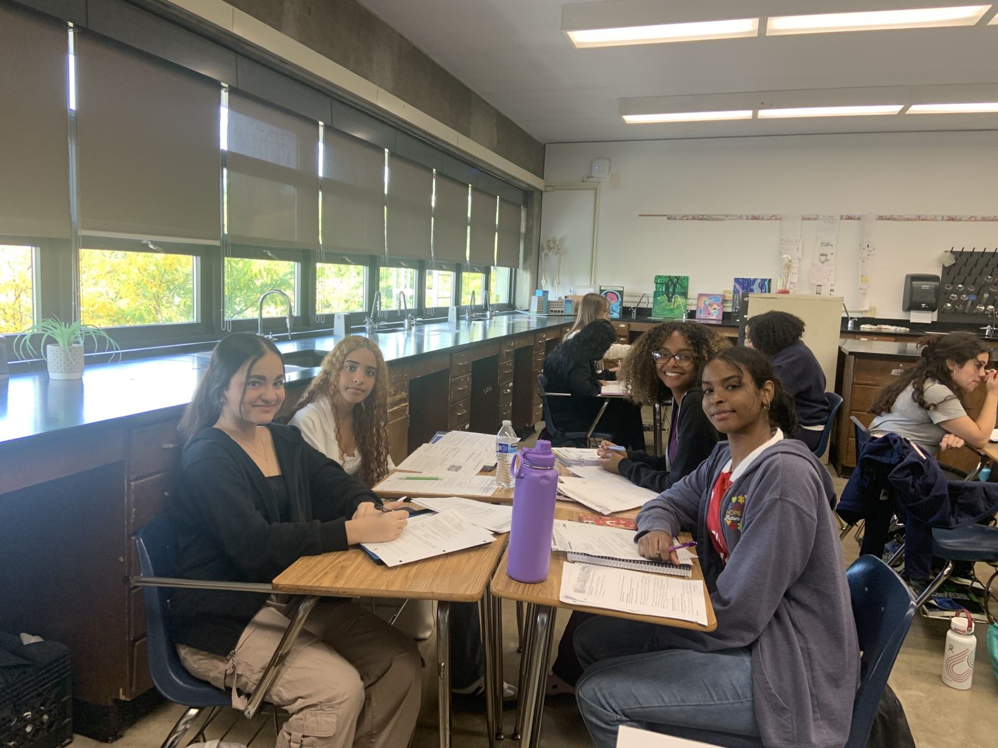
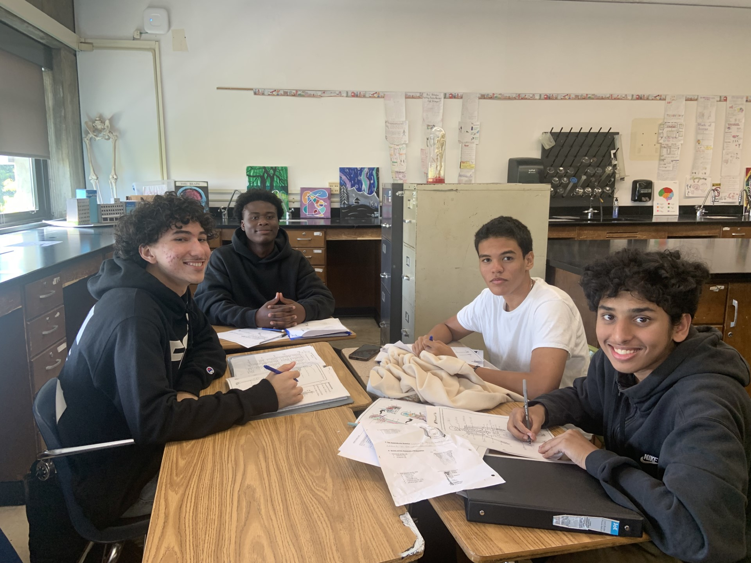
I am looking forward to a FABULOUS Year!

